Slide 1

Object-Graph Tools / Ronald Bode (iRon7)
Translation: Judicial IT Organization
Ministry of Justice and Security
Team “Automation”
Notes:
Slide 0: this slide will not automatically turned over. Show this BEFORE the acutal presentation starts.

Slide 2



We are
A department that provides ICT service for the entire Ministry of Justice and Security of the Netherlands.
We automate all our applications with PowerShell.
Besides, I like to write open-source solutions for the PowerShell community
1 / 20
Notes:
We are Team Automation.
A department that provides ICT service for the entire Ministry of Justice and Security of the Netherlands.
We automate all our applications with PowerShell.
Besides, I like to write open-source solutions for the PowerShell community

Slide 3
About Object-Graphs
An object-graph is a network of embedded arrays, dictionary/objects that are linked together
Object-Graphs are often retrieved from an object notation, as:
Json
Yaml
Psd1
But could also already in-memory
2 / 20
Notes:
About Object-Graphs
An object-graph is a network of embedded arrays, dictionary/objects that are linked together
Object-Graphs are often retrieved from an object notation, as:
Json
Yaml
Psd1
But could also already in-memory

Slide 4
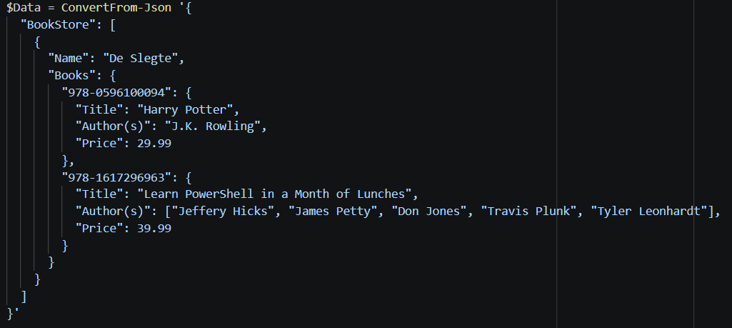
Bookstore example
Take the following object-graph from retrieved Json:
3 / 20
Notes:
Bookstore example
Take the following object-graph from Json:
(Which could be much more complex)
Note the ISBN keys, and PowerShell book title

Slide 5
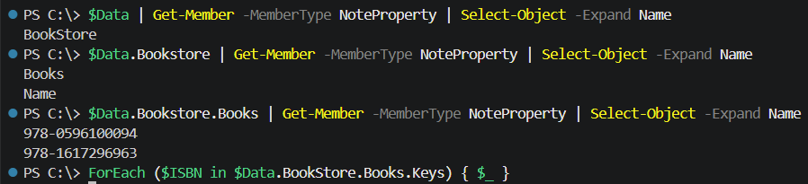
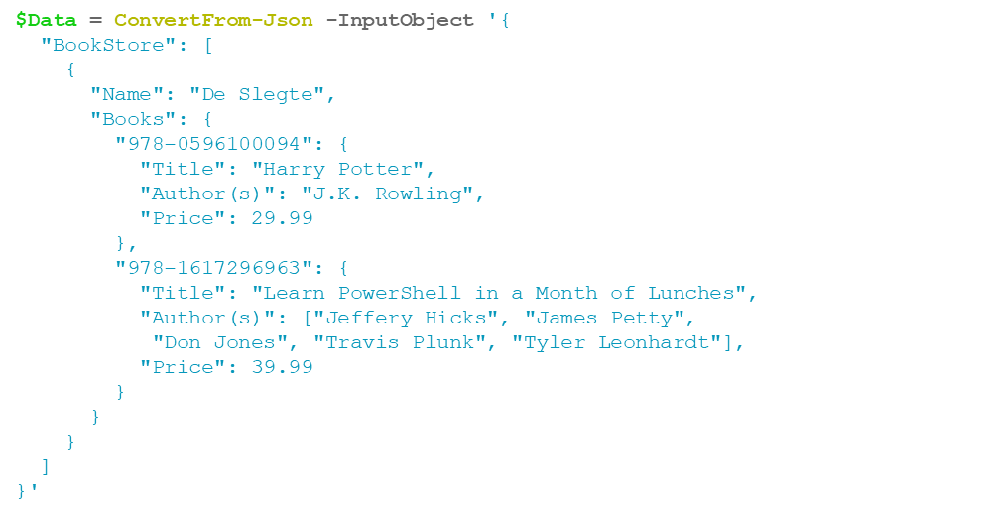
Finding a book
As a user, I would like to change the price of the PowerShell book. problem: 3x times Get-Member and no results for the ForEach… Nodes are difficult to find and expensive to target.
4 / 20
Notes:
Bookstore example
As a user, I would like to change the price of the PowerShell book.
3 times a Get-Member
And than a foreach loop
But no results…
Why?
Because the properties (name and values) of the books are hidden in the .PSObject property of the PSCustomObject

Slide 6
Other object-graph issues
Other issues and pitfalls that you might encounter while addressing a node in an object-graph
Member-Access enumeration
Collections with a single property that suddenly unroll
Fixed size Arrays
PSCustomObjects vs any Dictionaries
Cyclic properties
Performance
5 / 20
Notes:
Other object-graph issues and pitfalls
Other issues and pitfalls that you might encounter while addressing a node in an object-graph
Member-Access enumeration
Collections with a single property that suddenly unroll
Fixed size Arrays
PSCustomObjects vs any Dictionaries
Cyclic properties
Performance

Slide 7
Featuring Object-Graph tools
The ObjectGraphTools Module might help you here with
Navigating
Easy targeting nodes
A flat Iteration through (all) nested nodes
Consistent treatment of lists and dictionaries structures.
Converting to and from PowerShell Expressions
A set of cmdlets to manipulate complex object-graphs.
6 / 20
Notes:
Featuring Object-Graph tools
The ObjectGraphTools Module might help you here with
Navigating
Easy targeting nodes
A flat Iteration through (all) nested nodes
Consistent treatment of lists and dictionaries structures.
Converting to and from PowerShell Expressions
A set of cmdlets to manipulate complex object-graphs.

Slide 8
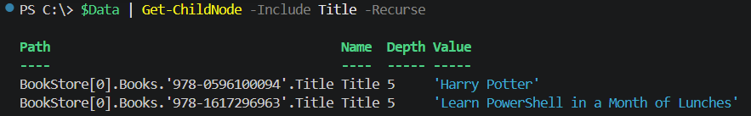
Get-ChildNode
Similar to Get-ChildItem for files, you can use Get-ChildNode to list your Object-Graph properties
7 / 20
Notes:
Get-ChildNode
Similar to Get-ChildItem for files, you can use Get-ChildNode to list your Object-Graph properties
You might do a recursive search and filter the selection
Just select leaf nodes,
And get the complete node object or just the contents (value) of the node

Slide 9
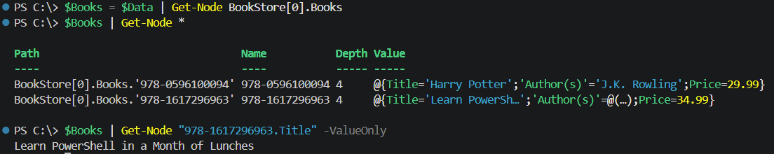
Get-Node
Similar to Get-Item, you can use Get-Node to retrieve one or more specific nodes with their properties and related methods
8 / 20
Notes:
Get-Node
Similar to Get-Item, you can use Get-Node to retrieve one or more specific nodes with their properties and related methods
And again I might just get the value or node object and continue from there

Slide 10
PSNode
Major methods and properties
Add() (even for fixed size array nodes)
ParentNode: refers to the parent node
RootNode: refers to the root node
ChildNodes: a list of (direct) child nodes
DescendantNodes: a list of all descendant nodes
LeafNodes: a list of all the leaf nodes
Path: the exact path to the concerned node
Value: the value of object embedded in the node
ValueType: the type of the value embedded in the node
…
9 / 20
Notes:
Major methods and properties
Every node will have a large variety of properties and methods
Add(): For a [PSList] node, it adds a node to the list, no matter it concerns a fixed array or not. For a [PSMapNode] node, it will add a node with a value. No matter it contains either a (PSCustom)Object or any dictionary.
This also counts for methods as Remove(), Contains(), GetValue(), SetValue() etc.
It is also allowed to add a node using the + (or +=) operator
ParentNode: refers to the parent node
RootNode: refers to the root node
ChildNodes: a list of (direct) child nodes
DescendantNodes: a list of all descendantnodes
LeafNodes: a list of all the leaf nodes
Path: the exact path to the concerned node
Value: the value of object embedded in the node
ValueType: the type of the value embedded

Slide 11
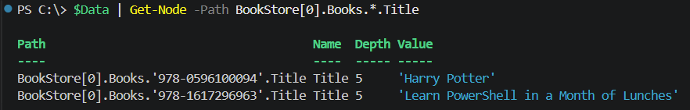
Extended Dot Notation (XDN)
Besides Get-Node supports Extended Dot Notation similar to XPath:
Wildcard support (? and *)
Additional operators
A ancestor (..) selector to select the parent node or an ancestor
A descendant (~) selector to select a (deep) descendant node
Offspring (~~) selector to select all (deep) offspring nodes (version 0.3.3+)
An equals (=) filter to select a (leaf) node with a specific value
A logical “Or” (/) selection list to represent a list of possible names or values
10 / 20
Notes:
Extended Dot Notation (XDN)
Besides Get-Node supports Extended Dot Notation similar to XPath:
Including wildcard support
$Data | Get-Node -Path BookStore[0].Books.*.Title
Path Name Depth Value
---- ---- ----- -----
BookStore[0].Books.'978-0596100094'.Title Title 5 'Harry Potter'
BookStore[0].Books.'978-1617296963'.Title Title 5 'Learn PowerShell in a Month of Lunches'
And Additional operators A ancestor (..) selector to select the parent node or an ancestor
A descendant (~) selector to select a (deep) descendant node
Offspring (~~) selector to select all (deep) offspring nodes (version 0.3.3+)
An equals (=) filter to select a (leaf) node with a specific value
A logical Or (/) selection list to represent a list of possible names or values

Slide 12
Xdn Example
To come back on the use case, this is how you might select and change the price of the PowerShell book:
1 2 3 4 5 6
Select the descendant Books node
From there, select the descendant Title node
With the a name like: *PowerShell*
Select the parent
Select the Price (sibling)
Change the Price value
11 / 20
Notes:
PSNode Example
# give a discount of 5 dollar on each PowerShell book
PS C:\Users\Gebruiker\Documents\PoshaKucha\ObjectGraphTools> ($Data | Get-Node ~Books~Title=*PowerShell*..Price).foreach{ $_.Value -= 5 }
PS C:\Users\Gebruiker\Documents\PoshaKucha\ObjectGraphTools> $Data | ConvertTo-Json -Depth 9
Select the descendant Books node
From there, select the descendant Title node
With the a name like *PowerShell*
Select the parent
Select the Price (sibling)
Subtract 5 from the current value

Slide 13
The world isn’t flat
Most standard cmdlets don’t work well with object-graphs:
Where-Object, ForEach-Object, Compare-Object, Group-Object, Sort-Object, Select-Object and even Get-Member (often used at design time)
Simply because they assume a flat object.
You need to invoke them (start a new pipeline!) several times to get to your node.
Therefore, I have added some more Object-Graph cmdlets based on the PSNode class…
12 / 20
Notes:
Most standard cmdlets don’t work well with object-graphs:
Simply because they assume a flat object.
You need to invoke them several times to get to your node.
Therefore, I have added some more Object-Graph cmdlets based on the PSNode class…

Slide 14
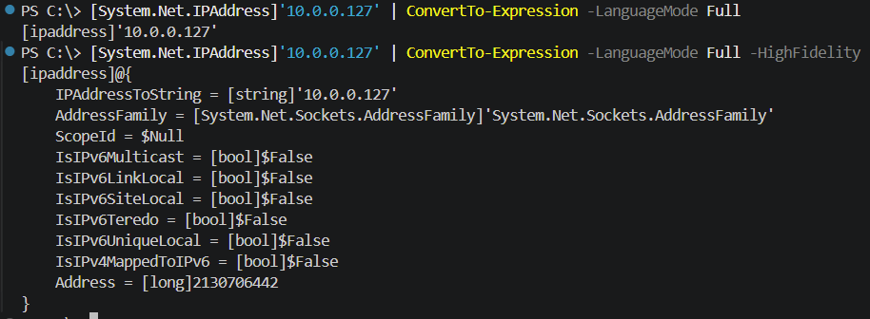
ConvertTo-Expression
Serializes an object to a PowerShell expression.
13 / 20
Notes:
ConvertTo-Expression
ConvertTo-Expression [-InputObject] <Object> [[-LanguageMode] {FullLanguage | RestrictedLanguage | NoLanguage | ConstrainedLanguage}] [[-ExpandDepth] <Int32>] [-Explicit]
[-FullTypeName] [-HighFidelity] [-ExpandSingleton] [[-Indent] <String>] [[-MaxDepth] <Int32>] [<CommonParameters>]
Examples:
$Data | ConvertTo-Expression
$Data | ConvertTo-Expression -LanguageMode Constrained
[System.Net.IPAddress]'10.0.0.127' |
ConvertTo-Expression -LanguageMode Full
[ipaddress]'10.0.0.127‘
[System.Net.IPAddress]'10.0.0.127' |
ConvertTo-Expression -LanguageMode Full -HighFidelity
[ipaddress]@{
IPAddressToString = [string]'10.0.0.127'
AddressFamily = [System.Net.Sockets.AddressFamily]'System.Net.Sockets.AddressFamily'
ScopeId = $Null
IsIPv6Multicast = [bool]$False
IsIPv6LinkLocal = [bool]$False
IsIPv6SiteLocal = [bool]$False
IsIPv6Teredo = [bool]$False
IsIPv6UniqueLocal = [bool]$False
IsIPv4MappedToIPv6 = [bool]$False
Address = [long]2130706442
}

Slide 15
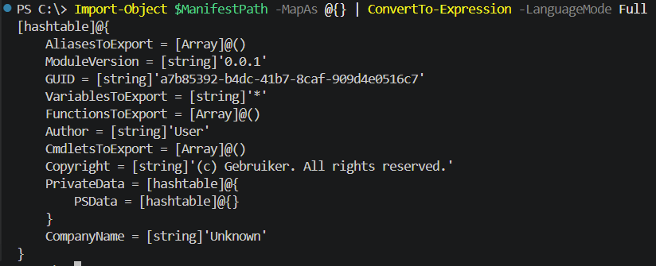
ConvertFrom-Expression
(Safely) Serializes an object to a PowerShell expression.
14 / 20
Notes:
ConvertFrom-Expression
ConvertFrom-Expression [-InputObject] <String> [[-LanguageMode] {FullLanguage | RestrictedLanguage | NoLanguage | ConstrainedLanguage}] [[-ListAs] <Object>] [[-MapAs] <Object>] [<CommonParameters>]
Serializes an object to a PowerShell expression
The Import-ObjectGraph cmdlet is based on ConvertTFrom-Expression cmdlet and has similar parameters. Both cmdlets parsing the content rather than invoking (or dot-sourcing) it. The difference with Import-PowerShellDataFile is that it can convert and constrain the collection types (see also Copy-ObjectGraph).

Slide 16
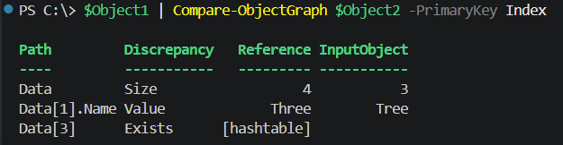
Compare-ObjectGraph
Recursively compare all the nodes in an object-graph
It supports a loosely typed collection structure, but could also do a strict compare.
Notes:
Compare-ObjectGraph
Recursively compare all the nodes in an object-graph
It supports a loosely typed collection structure, but could also do a strict compare.

Slide 17
Merge-ObjectGraph
Recursively merge all the nodes in an object-graph
using a specific property as primary key
And it also supports a loosely typed collection structure for both objects.
Notes:
Merge-ObjectGraph
Recursively merge all the nodes in an object-graph
using a specific property as primary key
General treatment of lists and dictionaries/PSCustomObject structures.

Slide 18
And more…
Sort-ObjectGraph Recursively sorts all the nodes in an object-graph
Including primary key support
Copy-ObjectGraph Recursively (deep) copies all the nodes in an object-graph
With the ability to change your array/list types and dictionary/(PSCustom)Object types
Notes:
Sort-ObjectGraph Recursively sorts all the nodes in an object-graph
Including primary key support
Copy-ObjectGraph Recursively (deep) copies all the nodes in an object-graph
With the ability to change your array/list types and dictionary/(PSCustom)Object types

Slide 19
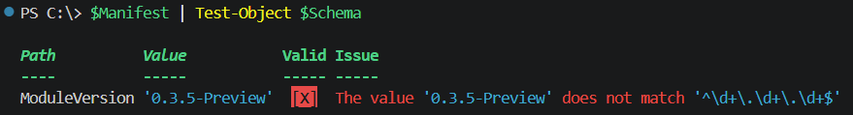
Test-ObjectGraph (version 0.3.5-preview)
Test an object-graph independent of any notation and is purely object based.
It also supports a loosely typed collection structure for the input object and the schema
Notes:
Test-ObjectGraph (version 0.3.5-preview)
Test an object-graph independent of any notation and is purely object based.
It also supports a loosely typed collection structure for the input object and the schema

Slide 20
You want to try it?
The ObjectGraphTools module is available from the GitHub at:
https://github.com/iRon7/ObjectGraphTools
You can install it directly from the PowerShell console via the ObjectGraphTools NuGet Page using the following command:
Install-Module -Name ObjectGraphTools
Notes:
Installation
The ObjectGraphTools module is available from the GitHub at:
https://github.com/iRon7/ObjectGraphTools
And from the PowerShell Gallery at:
https://www.powershellgallery.com/packages/ObjectGraphTools
You can install it directly from the PowerShell console via the ObjectGraphTools NuGet Page using the following command:
Install-Module -Name ObjectGraphTools

Slide 21
Q&A’s
PoshaKucha’s do not have an question and answer session but if you do have any question or like to challenge the object-graph solution:
Please, don’t hesitate to approach me here or via the issues tab of the concerned GitHub repository.
Notes:
Q&A’s
PoshaKucha’s do not have an question and answer session but if you do have any question or like to challenge this solution:
Please, don’t hesitate to approach me here or via the issues tab of the concerned GitHub repository.

